Slide 1
The Bridge
Program Overview
Love, Dignity and Respect

Slide 2
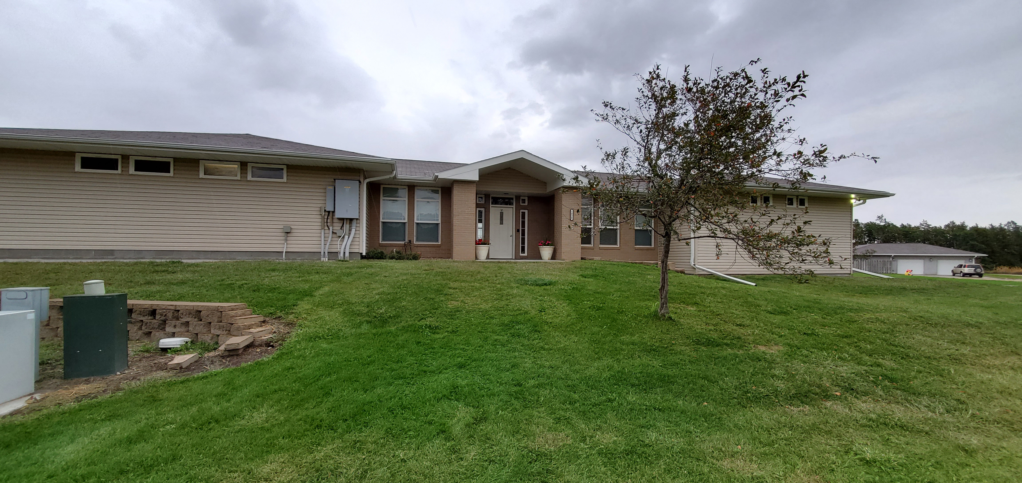
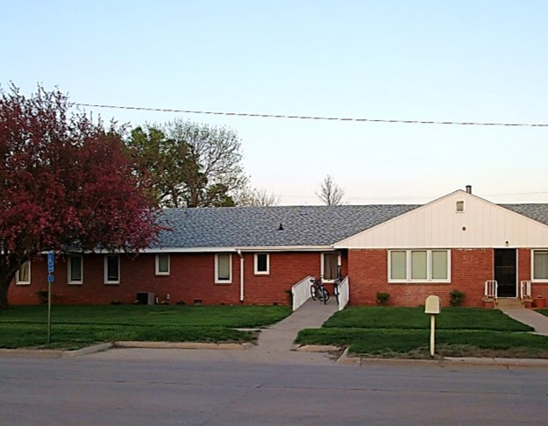
The Bridge Facilities
West Wing
East Wing
Strong Women Stand Together

Slide 3
About Us
The Bridge Inc., Program
Our goal is to facilitate re-socializing of Bridge residents to reunite them with family and communities as healthy, confident and contributing members of society.
The Bridge Inc., is a therapeutic Community for women recovering from alcoholism and drug addiction.
We implement an educational model of living skills.
The Bridge Inc., implements trauma-informed care which understands the impact of trauma and potential paths for recovery.
Employees are trained to identify signs and symptoms of trauma and acknowledges this in our policies, procedures and practices.
The Mission of The Bridge, Inc. is to provide a holistic substance abuse recovery program for women and their families in a safe and nurturing environment.

Slide 4
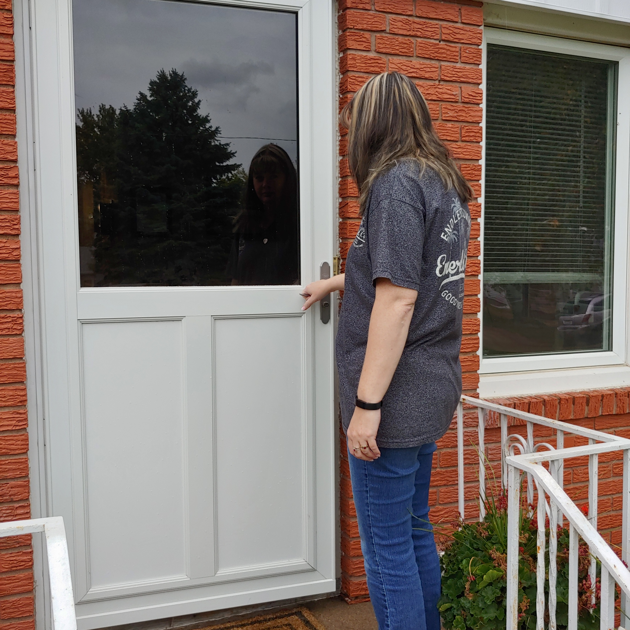
Welcome to
The
Bridge
Admission

Slide 5
Admission Procedures - Referrals
Clients access The Bridge Therapeutic Community services through referral and intake process.
Referrals are made through a variety of diverse human services, alcohol and drug treatment programs, community members and self-referral.
Once referred, client completes an intake assessment
Client’s intake is evaluated by the Clinical Director using criteria adapted by the American Society of Addiction Medicine, Patient Placement Criteria 2nd edition.
Criteria indicated appropriate dimension, which must be met, to properly place the client.
If client meets the criteria, they are offered an opening or placed on a waiting list for admission

Slide 6

Admission Procedures - Interim Services
Perspective client will contact The Bridge Inc. and request an intake.
The staff member will begin by addressing interim services with the applicant.
The focus of interim services is to reduce the adverse health effects of abuse, promote individual health and reduce the risk of transmission of disease until the applicant is admitted to a treatment program
Interim services include but are not limited to:
Intake are completed over the phone by a trained staff member. If necessary, other options can be arranged.
Priority of Admission –
1. Pregnant IV drug user
2. Pregnant
3. IV Drug User
4. Women with Dependent Children
Counseling and education about HIV and tuberculosis
Risks of needle-sharing
The effects of alcohol and drug use on the fetus
Referral for prenatal care
Risk of transmission of sexual partners and infants
Steps to take to ensure transmission does not occur
Referral for HIV and TB treatment services if necessary

Slide 7

Clinical Staff
Jill Gregg - Director, MS, LIMHP, LADC
Kellie Stone– Clinical Program Coordinator,
MA, LIMHP – West Wing
Teri Bykerk – Counselor, MS PLADC –
East Bridge
Cheryl Blankenship – Counselor, MS, PLMHP,
LADC – East Bridge
Amy Case – BS, PLADC – West Bridge
Kortney Dement – BS, PLADC – East Bridge
Cary Bonow – East Bridge
Michelle Parker Hill – West Bridge
Case Managers

Slide 8

Case Management
Putting the Pieces Together
On admit, each resident is assigned a case manager. Service planning documents help case managers coordinate services:
Planning and Coordinating
Weekly Budgeting
Address Changes
Obtain Birth certificate
Social Security Card
Vehicle registration and insurance
Apply for Snap, WIC, ADC and Medicaid
Connecting with support agencies – Lion’s Club, YWCA Career Closet,
Establish school and daycare
Medical needs – physician, medications, immunization records, dental
Find Employment
Weekly Budgeting – bills, debt, savings
Credit Management
Open a checking/savings account
Preparing for transition phase
Applying for housing
Identify ongoing expenses
Rent
Medications
Car Expenses – insurance, gas, repairs
Child support
Childcare
Child Expenses
Personal Spending
Savings
Restoring credit
Pull credit report
Identify debts
Contact creditors
Budget for payment of debt
Create positive credit

Slide 9
Case Management
Putting the Pieces Together Takes a Village
A large part of case management is the Coordination of Services with other agencies to help meet the needs of the residents.
Mary Lanning Memorial Clinics
Department of Health and Human Services
Vocational Rehabilitation
Adam County Extension Office
Dr. Susan Linblad
Catholic Social Services
Healthy Beginnings
Beginnings Child Care
Head Start
Early Head Start
Pooh corner
YMCA
YWCA
Child Protective Services
Central Nebraska Consumer Credit
Hastings Public Schools
Spouse Abuse Sexual Assault Crisis Center
Court Appointed Special Advocates
Hastings Housing Authority
Hastings Family Planning
Women Infant and Children Program
Central Nebraska Drug Court
Crossroads Mission
Alcoholics Anonymous
Narcotics Anonymous
Probation Office
Parole Office

Slide 10
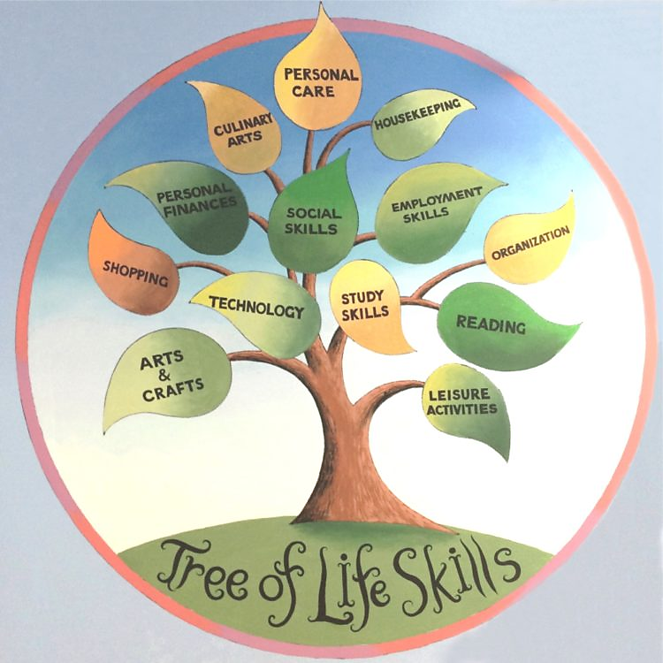
Programming
Each resident participates in an intensively structured program.
Minimum of 30 units of therapeutic interventions per week.
Basic weekly Programming includes:
Domestic Violence Group with SASA -
Addiction and Recovery Psychoeducational classes
Trauma Recovery Group
Self-Sufficiency Workshops,
Group Therapy twice weekly
Minimum of two individual counseling sessions
Weekly individual and family case management
Daily Living Skills
12-step assignments
AA/NA In-House and community meetings
Employment seeking – Employment
Meal planning, grocery shopping, family style dinners
Community Service
Self-care Techniques
“Bridging the Gaps” – family focused treatment day

Slide 11
Programming
Learning to Live a Healthy Lifestyle
Addiction & Recovery 101 – educate and assist residents in developing healthier behaviors and thinking patterns, develop a knowledge of addiction and the effects on themselves and their families.
Survivors Group – reduce suffering, improve functioning, and reduce long-term effects of trauma through cohesion, normalization and containment to help the resident cope. “Courage to Heal” and “Seeking Safety: Curriculum
Self-Sufficiency Workshops – educational components of lifelong skills to increase independence and self sufficiency in their daily lives.
In-House Recovery Meetings – facilitated by residents and resembles the traditional 12-step meetings. Alumnae and women in the recovery community are encouraged to attend.
Self-Care Groups – self-care is core in recovery. Yoga, mindfulness, meditation, exercise, journaling, group activities and family activities.
“Bridging the Gap” – Family Treatment Day - helps family members improve communication, understand the roles family members take on, create a safe environment for family members to discuss concerns, fears, and how they have been effected and create an overall better functioning home environment. The day includes a one-hour educational lecture, one-hour family therapy group, one-hour family activity and a family meal.
Community Involvement –
Aftercare – weekly one-hour group, available on-site and online, offered to alumnae to address therapeutic, recovery and parenting questions/needs as they transition into the community. This group also allows residents to develop and maintain a support network from within the program.
Community Service – local nonprofits and agencies
Recovery events – being of service at community events
12-step community – attending, facilitating and being of service at meetings

Slide 12
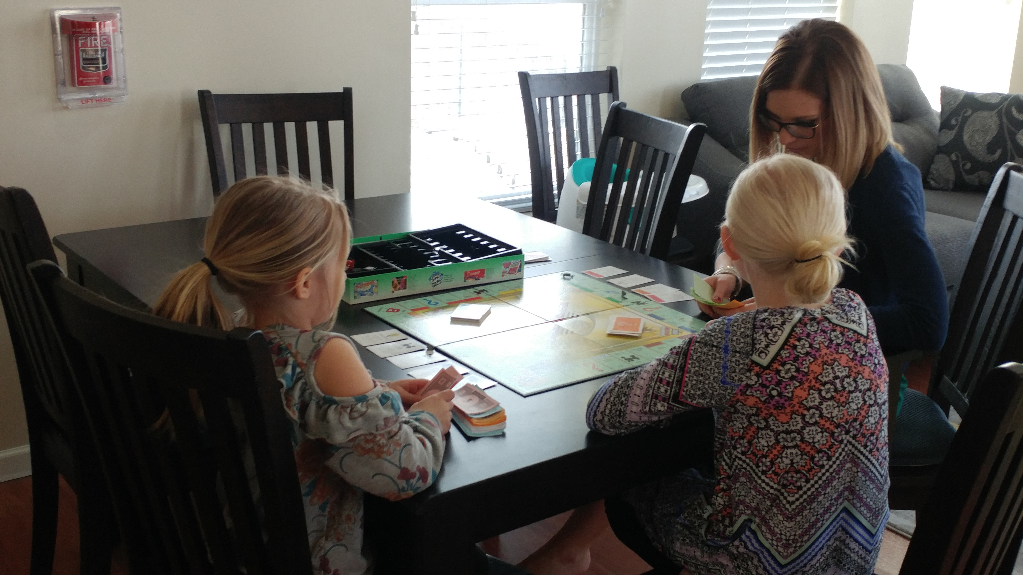
Mom and Me
Parent Child Trauma Assessment
Family Oriented
Next Steps with Sue – Sue Overturf, RN
Family Component
Parenting risk assessment
Research based discipline tools
Education of child growth and development
Providing referrals
Resource referrals to support positive parenting
Providing support to Bridge support workers
Individual, child and family counseling sessions
Being the Best Parent I Can Be
Client-Centered – adaptive to ensure relevance
Growth and development
Bonding and Attachment – Circle of Security
Relational – relationships as tools for learning and growth
Strengths-Based – adult learning and behavior change theory
Multi-Dimensional – holistic, personal and family development
Health care referrals – mental and physical health interventions
Early Development Network
Head Start
Department of Education
Team goal to assist the child to be successful in their educational and living environments

Slide 13

Personnel Development and Training
The Bridge, Inc. is committed to assisting employees to improve their skills and education by providing off and onsite trainings.
Supervisors fill out check lists to ensure a basic orientation of new employees to their job position and agency policies within 30 days of hire.
Upon successful completion of training the check lists are placed in the employee’s personnel file.
Evaluations of staff training is completed annually by the Director during the performance review.
During the review, the employee can express to the Director any additional trainings they feel necessary.
The Bridge, Inc. maintains literature and videos in the Group room and individual counselor’s offices for staff to gain additional knowledge on a variety of topics.
The agency will provide the following trainings for all staff (as appropriate to their position) on an annual basis (or as required to maintain certification)

Slide 14
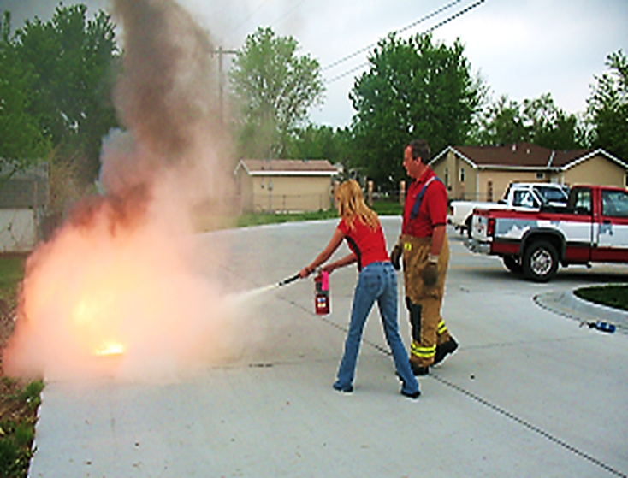
Personnel Development and Trainings
CPR and First Aid
Fire and fire suppression
Infection Control Plan and Universal Precautions
Health Issues and advocacy, including communications about health issues
Safety of clients
Unique needs of clients
Customer Service
Person and family centered services
Cultural competency/sensitivity
Reporting of suspected abuse and neglect
The rights of clients
Rights of personnel
Violence in the workplace
Confidentiality
Expectations regarding personal conduct
Professional boundaries
Competency-based safety training

Slide 15
Jillian Scott
Kellie Stone
402 462-4677
402 462 2552
Jillianscott@thehastingsbridge.com
kelliestone@thehastingsbridge.com

