Slide 1
Breaking the Cycle: Domestic-Violence Child Welfare Practice for Safety, Healing, and Prevention
Presented by:
Jamie bahm
Kim lauenroth

Slide 2


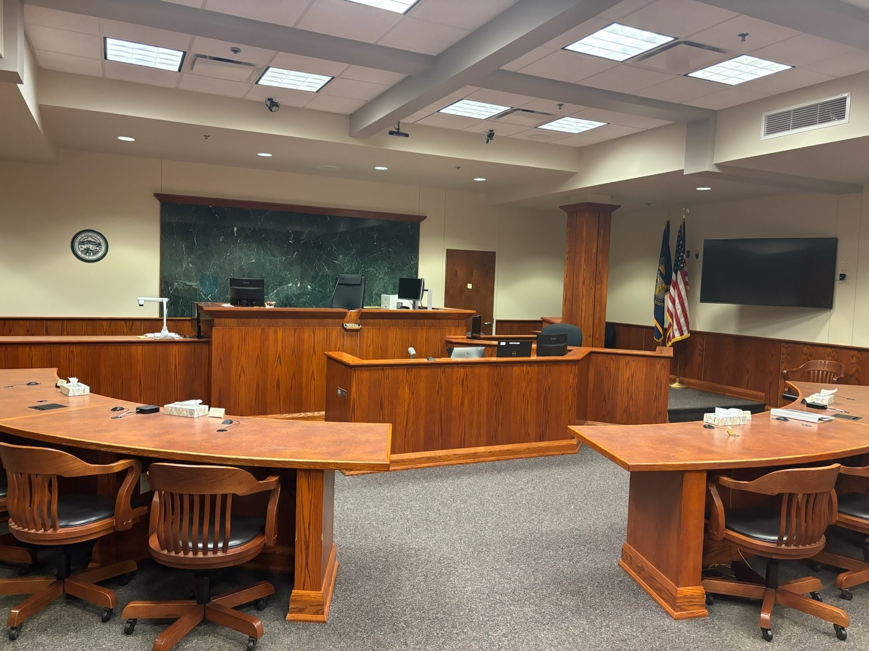
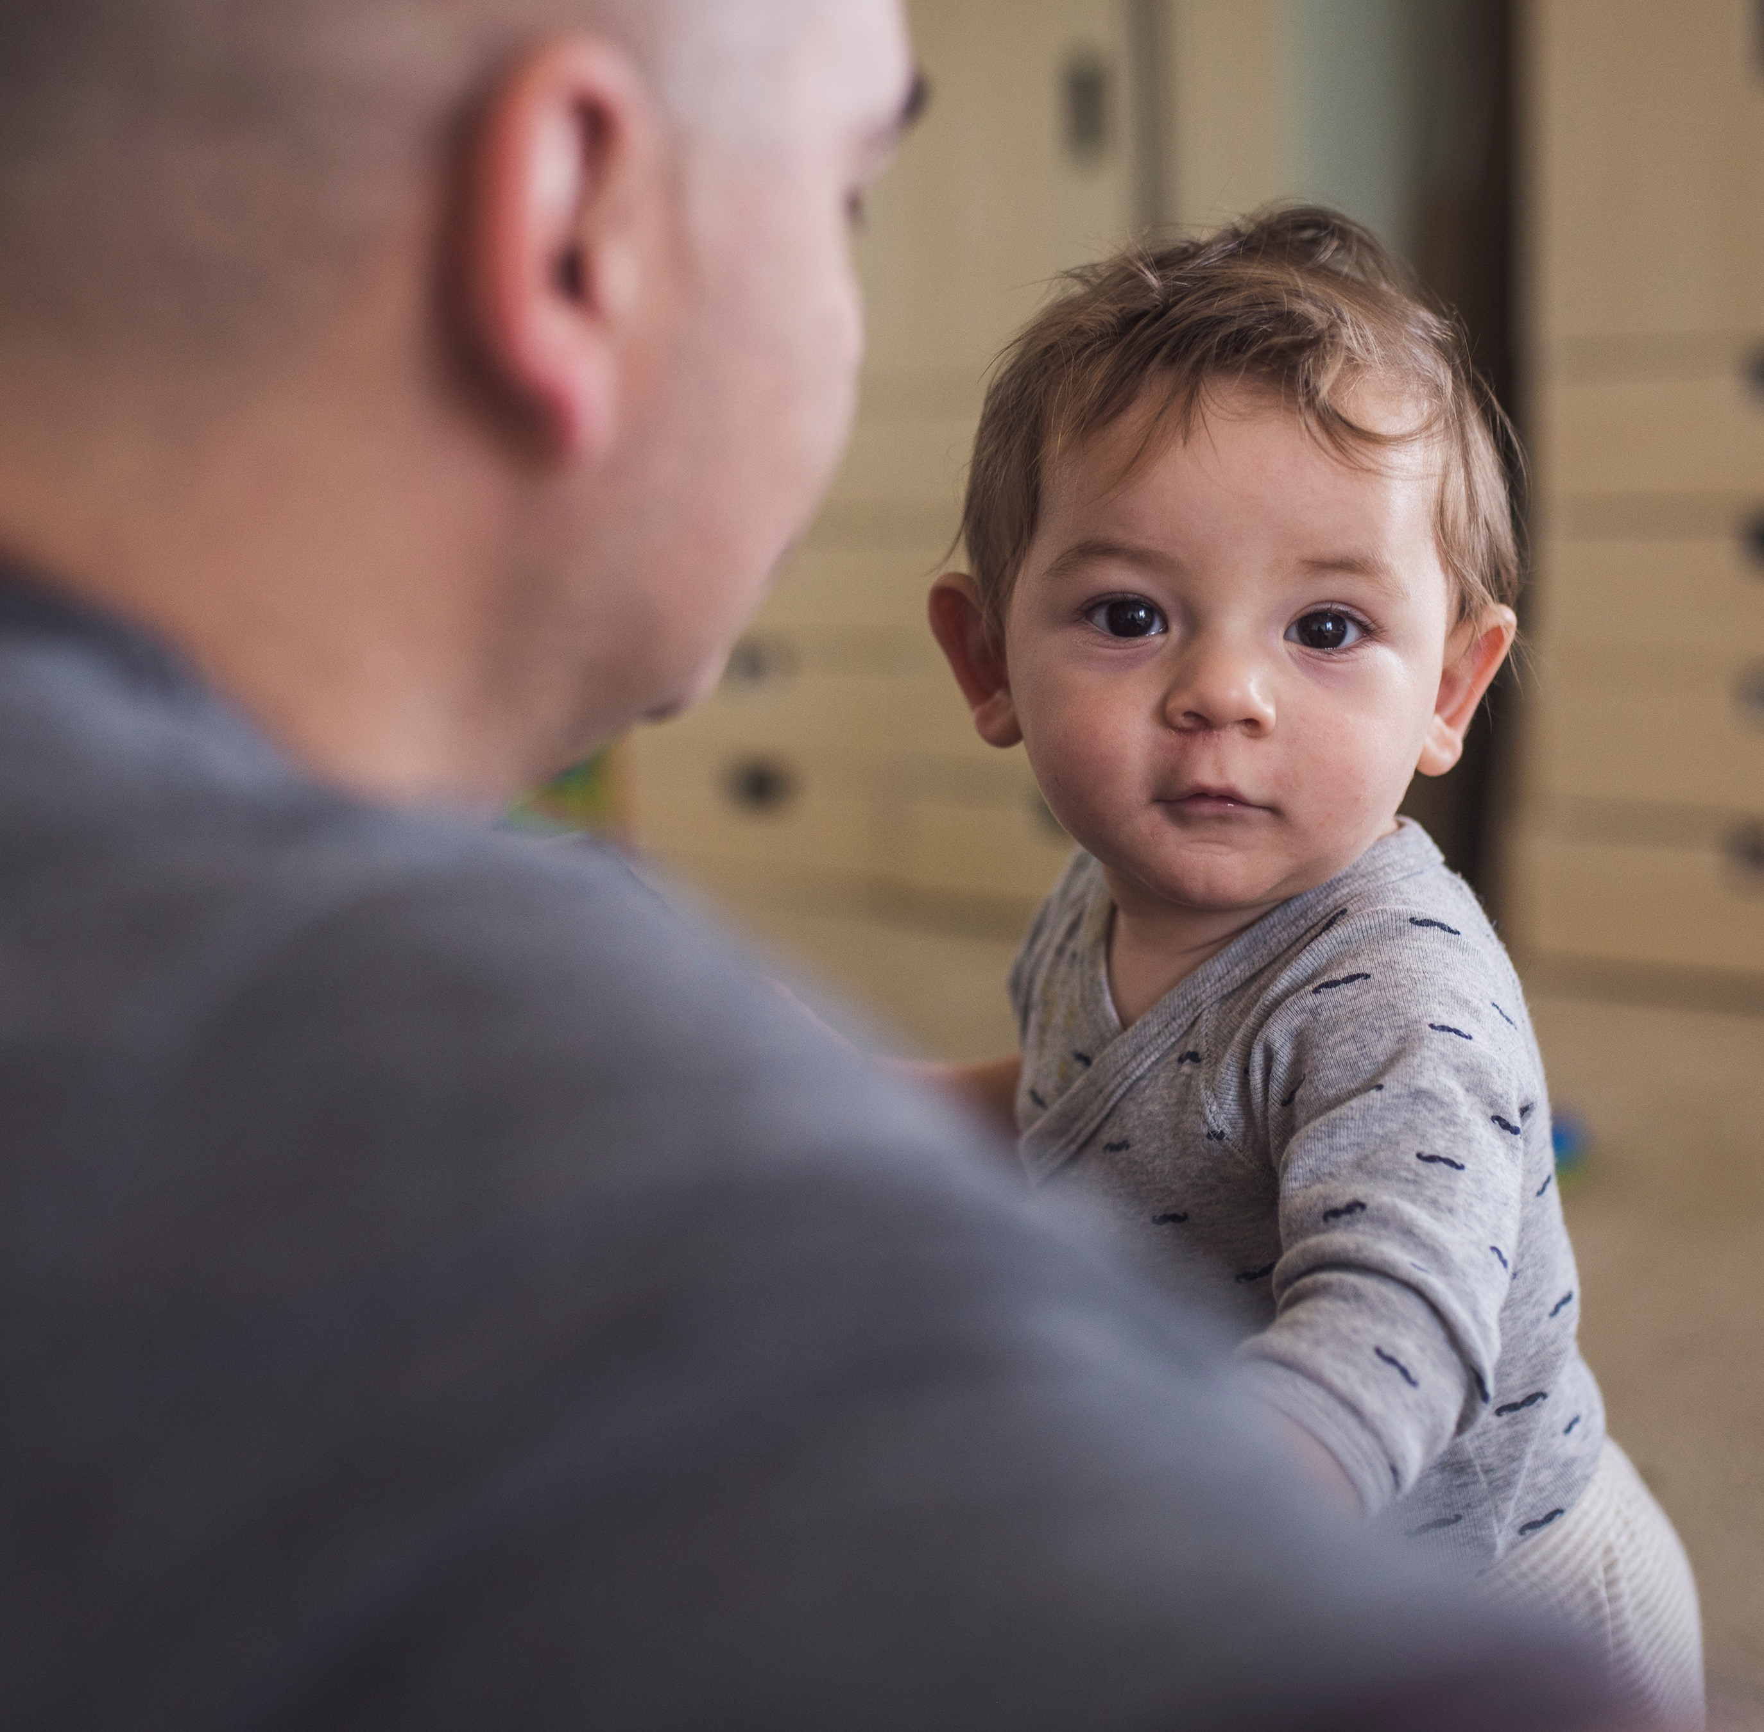
Agenda
Domestic Violence Basics
Your Role as a Professional
DV-Informed Strategies to Work with Survivors, Abusers, and Children

Slide 3
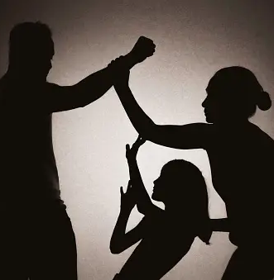

Domestic Violence Basics

Slide 4
Where does domestic violence come from?
“Abuse grows from attitudes and values, not feelings. The roots are ownership, the trunk is entitlement, and the branches are control.”
~Lundy Bancroft

Slide 5
A pattern of behavior by a perpetrator that creates a power imbalance between the intimate partners that creates real or feared risk of physical and sexual safety to one of the partners and to the child(ren) of the partner(s). These tactics include threats, coercion, intimidation, economic abuse, verbal abuse, using the children to assert power/control, using gender imbalances to assert power/control isolation, minimization, denial and blaming. These tactics may also include the use of physical and/or sexual violence.
Defining Domestic Violence
Notes:
The average number of assaults per year is 2-3. Psychological and other forms of abuse happen daily.

Slide 6
Nebraska Revised Statute 43-247 3(a)
The juvenile court in each county shall have jurisdiction of any juvenile who:
Who is homeless or destitute, or without proper support through no fault of his or her parent, guardian, or custodian; who is abandoned by his or her parent, guardian, or custodian; who lacks proper parental care by reason of the fault or habits of his or her parent, guardian, or custodian; whose parent, guardian, or custodian neglects or refuses to provide proper or necessary subsistence, education, or other care necessary for the health, morals, or well-being of such juvenile; whose parent, guardian, or custodian is unable to provide or neglects or refuses to provide special care made necessary by the mental condition of the juvenile; who is in a situation or engages in an occupation, including prostitution, dangerous to life or limb or injurious to the health or morals of such juvenile
Notes:
Historically, the default has been that the fault is on BOTH parents but we are moving away from that.

Slide 7
DHHS Domestic Violence Policy Objectives
Recognizing signs of domestic violence
Ensuring safety
Providing support and resources
Collaborative approach

Slide 8
State and National Data
Nebraska DHHS Hotline Calls, 2023
National Data on Families in the System with DV
NE DHHS, 2023
QIC – DV in Child Welfare, 2018

Slide 9

Why does he do that?

Slide 10
The Profile of an Abuser
Coercively controlling, intimidating, isolating
Entitled and self-centered
Believes he is the victim
Manipulative
Behavior driven by deep, long-held attitudes
Disrespectful, Superior, Depersonalizing
Lundy Bancroft, 2024

Slide 11
The Profile of an Abuser
Punishes, retaliates
Finds his abusive behavior rewarding
Mentality of ownership, objectification
Take-away: it’s not about anger and losing control
Lundy Bancroft, 2024

Slide 12
Contributing Factors
Substance misuse
Mental illness
Community collusion
Lack of consequences
Lundy Bancroft, 2024
Notes:
Mental illness is not causative in DV.

Slide 13
Myths about Abusers
Skill deficits
Psychopathology
Poor, ethnic minority
Lundy Bancroft, 2024
Notes:
When most people think of DV abusers they think of narcissists. Narcissism is a product of severe childhood wounds. DV shows up in the teen years and is a product of entitlement in intimate relationships. The two can co-exist but most times they don’t. IF he is also a narcissist, it’s even worse and the changes of change are even less.

Slide 14
Effects of Domestic Violence on Children
Attachment
Children don’t have to witness domestic violence to be affected by it
“Not understanding domestic violence is the biggest risk to child safety.”
~Kendra Thomas
Pervasive to the development of children
PTSD: 20-50%
Anxiety and Depression: 30-60%
Conduct and ODD: 40%

Slide 15
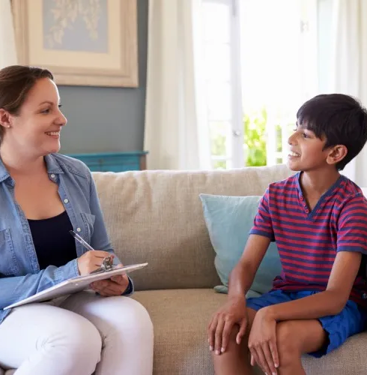

Your Role as a Professional

Slide 16
Your Role as a Professional
Don’t unknowingly make it worse.

Slide 17
The Role of Professionals Working with Abusers
Prioritize the safety of children and survivors – consider how interventions and your actions might impact their safety
Expect abusers to play on your emotions – watch your boundaries
Accountability is key
Focus on their behaviors and actions
Seek out specialized training and regular supervision/consultation

Slide 18
What is Our Goal?
The goal is NOT to end the domestic violence – you will forever be chasing this goal, if so!
Accept the relationship will continue → co-parenting and/or intimate
  How do we get there in the safest manner possible?
  Help the abuser see how his behaviors are a parenting choice and affecting his children
  Increase safety for the children and survivor
Professionals to work as a TEAM

Slide 19


Domestic Violence-Informed Strategies

Slide 20
Working with Survivors

Slide 21

Keep the Survivor’s Perspective at the Forefront – Rachel’s Story

Slide 22
Domestic Violence Survivors
Seek out her protective factors – challenge yourself and your thoughts!
Trust comes from transparency
Recognize she knows her abuser best
Timing is safety
Do not recommend couples counseling

Slide 23
Working with Abusers

Slide 24
Domestic Violence Abusers
Recognize domestic violence as his parenting choice and not just how he is as a partner
The survivor’s “side” as the default
Point out his controlling behaviors
Talk about the children and their experiences
Do not recommend couples counseling or anger management

Slide 25
Obstacles for Change
Denial
Minimization
Lack of empathy for the survivor
Lundy Bancroft, 2024

Slide 26
Elements of Change
Consequences
Education
Confrontation
Accountability
Lundy Bancroft, 2024

Slide 27
Working with Children

Slide 28
Children Affected by Domestic Violence
All children are impacted by domestic violence regardless of if they witness the violence
Recognize the default: children’s best interests are served in-home
Children become confused about who is responsible for the abuser’s behavior
Importance of therapy

Slide 29
Resilience in Children (Bancroft, 2024)
Strength of mother-child relationship
Mother’s protectiveness
Strength of sibling relationships
Other healthy relatives
Strength of peer relationships
Positive school experiences and relationships
Positive activities
Expressiveness
Safe feeling places to go
Not feeling guilty/blaming mom
Notes:
The closer kids are to their mom, the better they do. 100% of research supports this.

Slide 30
Children heal through… (Bancroft, 2024)
Repairing connection to mom and siblings
Experiencing increased safety
Healthy and attuned relationships with adults
Receiving appropriate reactions to their disclosures
Expressing and processing their experiences and distress
Learning healthy values

Slide 31
Questions?
Jamie Bahm
UNL Center on Children, Families and the Law
s-jfreema5@unl.edu
Kim Lauenroth
NE Department of Health and Human Services
Kim.Lauenroth@nebraska.gov

Slide 32
References
Bancroft, L. (2002). “Why does he do that?: Inside the minds of angry and controlling men”. Berkley Books.
Bancroft, L. (2024, April). Working with Domestic Violence. Presentation sponsored by the Safe and Healthy Families Initiative in Lincoln, NE.
Edleson, J.L., Mbilinyi, L.F., Shetty, S. K. (2021). Impact of domestic violence on children. Journal of Child Psychology, 45 (3), 123-135.
McTavish, J. R., Hinton, N.A., Williams, L. C. (2019). Mental health outcomes in children exposed to domestic violence. Pediatrics and Child Health, 32 (2), 78-90.
Nebraska Department of Health and Human Services. (2023). [Domestic Violence Data]. Provided to the UNL Center on Children, Families, and the Law.
Van der Kolk, Angela J. H. L. M. et al., (2022). Long-term effects of domestic violence on children's mental health. Trauma, Violence, & Abuse, 24 (4), 412-425.

